Slide 1

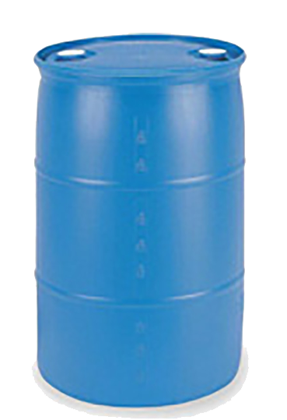
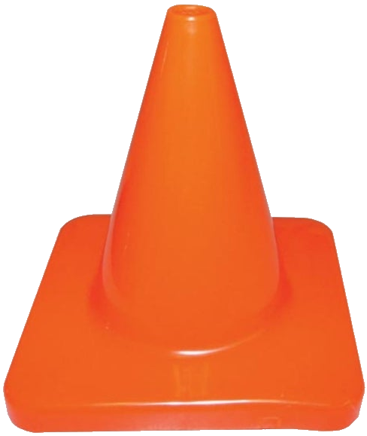

 | Renton Fish & Game Club Bay 7 Stage: One Round Clipazines Course Designer: Kris Erickson
“The idea that we don't have elimination of assault-type weapons, magazines that can hold multiple bullets in them is absolutely mindless. It is no violation of the second amendment. It is just a bow to the special interests, the gun manufacturers, and the NRA. It's gotta stop.” – Joe Biden, September 2, 2019. SCENARIO: Let’s try it once Sleepy Joe’s way, then finish up using magazines that hold multiple bullets. It’s just common sense.
START POSITION: Standing at start position, toes touching marks, firearm loaded with only 1 round. Handgun holstered, wrists below belt. PCC stock on belt, muzzle pointed at cone. |  | STRINGS: 1 SCORING: Unlimited SCORED HITS: Best 2 ROUND COUNT: 13 TARGETS: 6 IDPA, 1 PP START-STOP: Audible - Last shot CONCEALMENT: Required Muzzle Safe Points: 180 degree rule SO NOTES:
STAGE PROCEDURE: At start signal engage PP1 from start position. While moving to P1, you are surprised by T1. Engage remaining targets from available cover. NOTES: Engaging PP1 from outside of start position is a DQ.
PP1
T5
T4
T3
T1
T2
T6
P2
P1
PCC
Cone
START
https://www.youtube.com/watch?v=sKYYWc_7_iU&t=81

